Slide 1
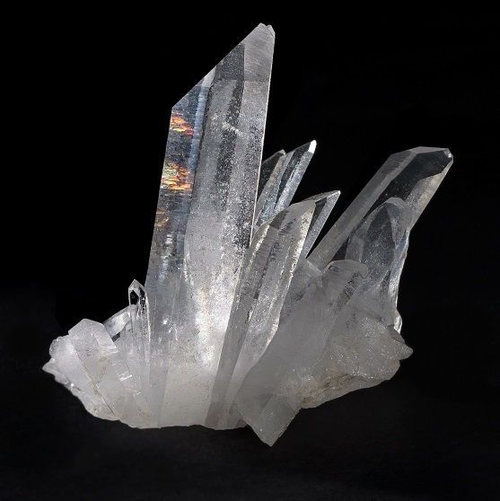
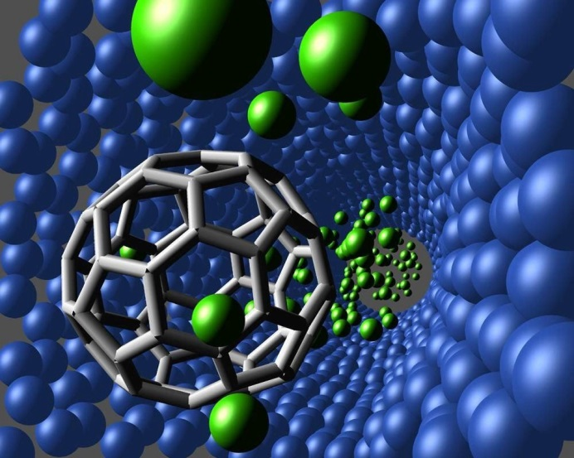
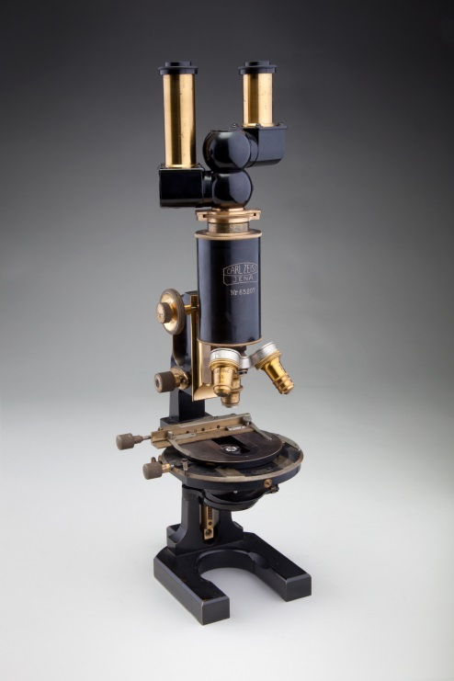
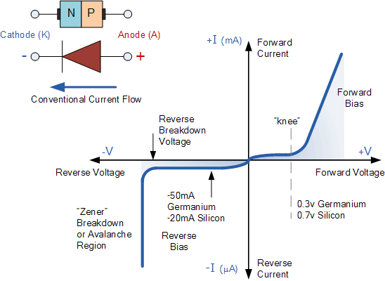
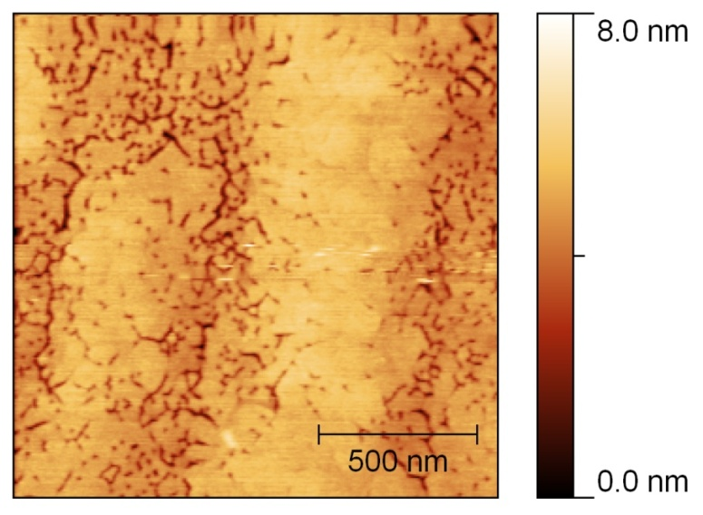
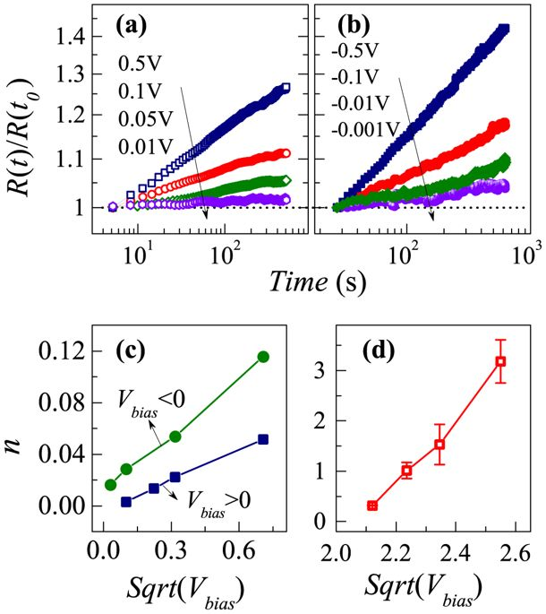
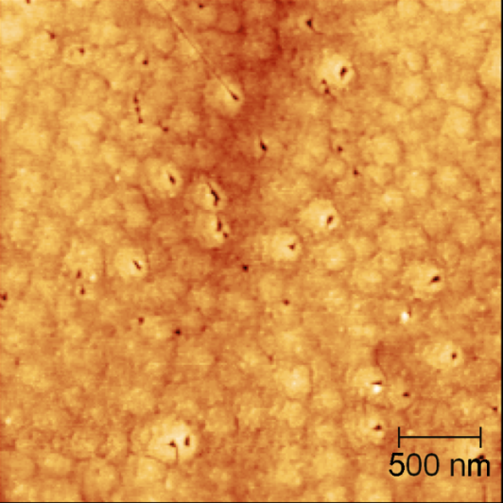
TITLE
Name 1 Name 2
affiliation
Poster abstract……
Feel free to change colors and dimension of boxes, this is an example, however you should describe the suggested points
Add text and figures to describe the work…
Motivations
AIMS
Materials and/ or Devices
Methods
Results
a)
Add and comment figures, explain the results
b)
Discussion
The proposed transport mechanism…
I
I
I
Free surface
TD
crack
V
V
V
TIP
GaN
TIP
AlInN/AlN/GaN
TIP
GaN/AlGaN/AlN/GaN
Conclusions
References

